Slide 1
Portfolio Theory I: Diversification and Characteristics of Portfolios of Risky Assets
Dr. Natasha Todorovic

Slide 2
Two-asset Portfolio Return and Risk

Slide 3
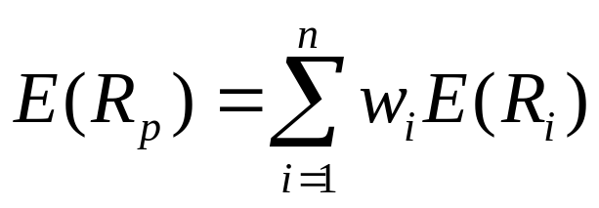
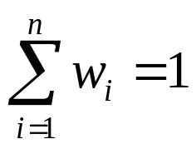
Calculating the Expected Return of a Portfolio
Amount invested in each security is of importance, i.e. the percentage of the total portfolio value invested in each asset in the portfolio - portfolio weights
Expected return of the portfolio is calculated as follows:
Where, E(R_{p}) is the expected return of the portfolio, w_{i} is portfolio weight of the i-th security and E(R_{i}) is the expected return of the i-th security in the portfolio
Also, the sum of weights in a portfolio should be equal to 1 (=100%):

Slide 4
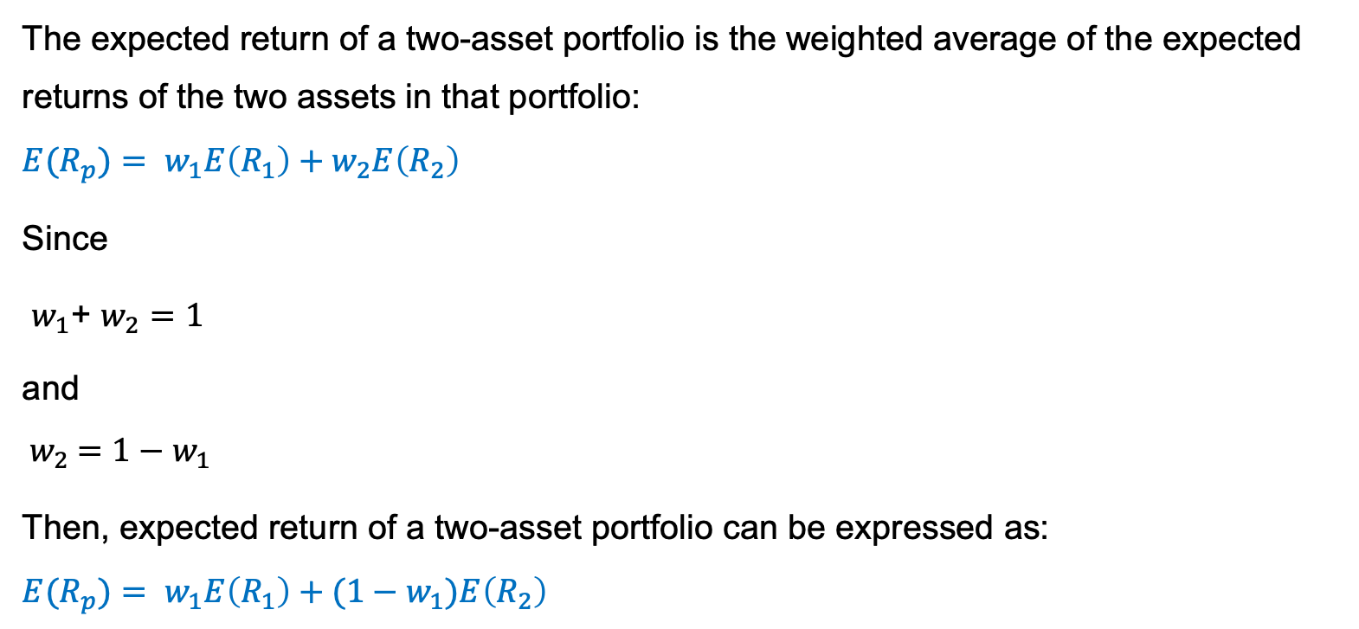
Expected return of a two-asset portfolio
The expected return of a two-asset portfolio is the weighted average of the expected returns of the two assets in that portfolio:
$${E(R}_{p})= w_{1}E\left(R_{1}\right)+w_{2}E\left(R_{2}\right)$$
Since
$w_{1}$+ $w_{2}=1$
and
$${ w}_{2} =1−w_{1}$$
Then, expected return of a two-asset portfolio can be expressed as:
$${E(R}_{p})= w_{1}E\left(R_{1}\right)+{(1−w}_{1})E\left(R_{2}\right)$$

Slide 5
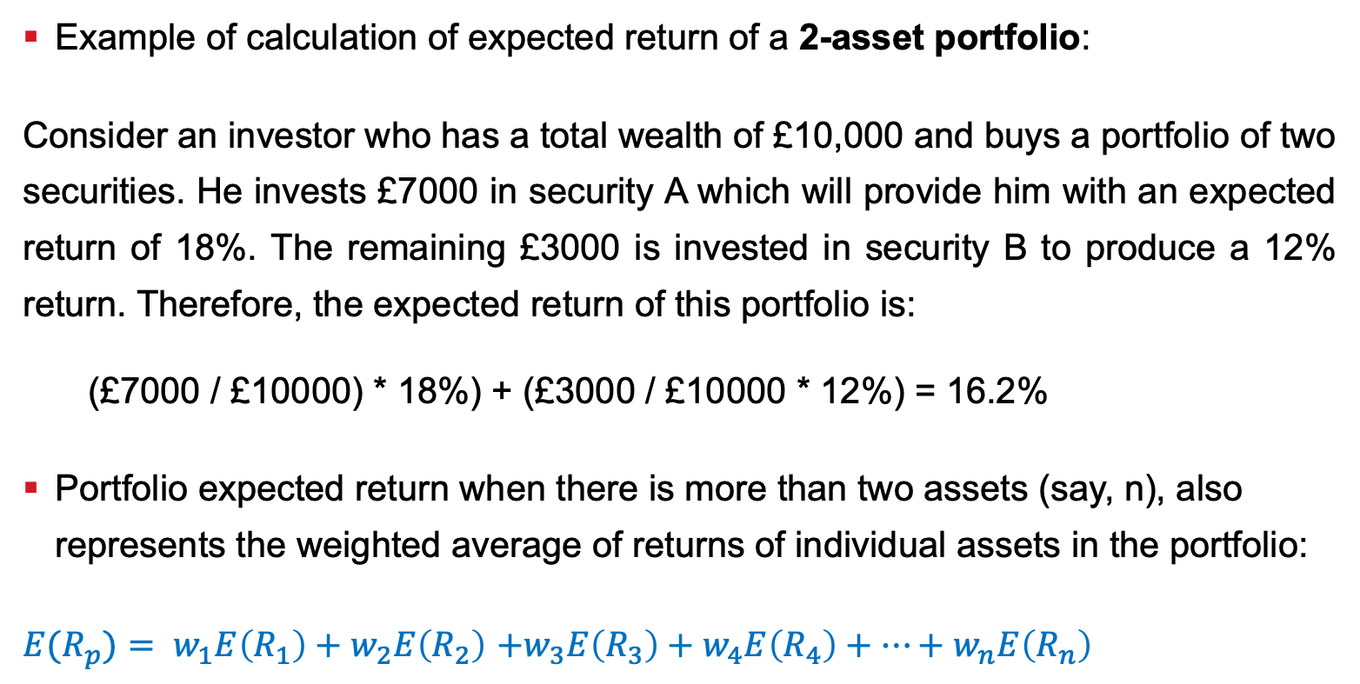
Calculating the Expected Return of a Portfolio, cont.
Example of calculation of expected return of a 2-asset portfolio:
Consider an investor who has a total wealth of £10,000 and buys a portfolio of two securities. He invests £7000 in security A which will provide him with an expected return of 18%. The remaining £3000 is invested in security B to produce a 12% return. Therefore, the expected return of this portfolio is:
  (£7000 / £10000) * 18%) + (£3000 / £10000 * 12%) = 16.2%
Portfolio expected return when there is more than two assets (say, n), also represents the weighted average of returns of individual assets in the portfolio:
${E(R}_{p})= w_{1}E\left(R_{1}\right)+w_{2}E\left(R_{2}\right)$ $+w_{3}E\left(R_{3}\right)+w_{4}E\left(R_{4}\right)+…+w_{n}E\left(R_{n}\right)$

Slide 6
Portfolio Return With Short-selling
In the previous example, the two weights are positive because we assume a long position in both assets
Negative weights would represent the opposite strategy - short selling or short position
  investor borrows shares from a broker, sells them at the current market price and buys back the shares later (hopefully) at the lower price
Short selling incurs unlimited losses
Note: the sum of weights is still equal to 1!
If in the example from the previous slide you short £2000 worth of security B and invest proceeds in security A, the return of such a two-asset portfolio is:
(£12000 / £10000) * 18%) + (- £2000 / £10000 * 12%) = 19.2%

Slide 7
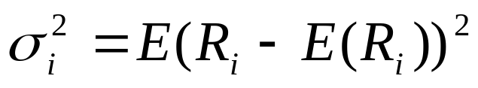
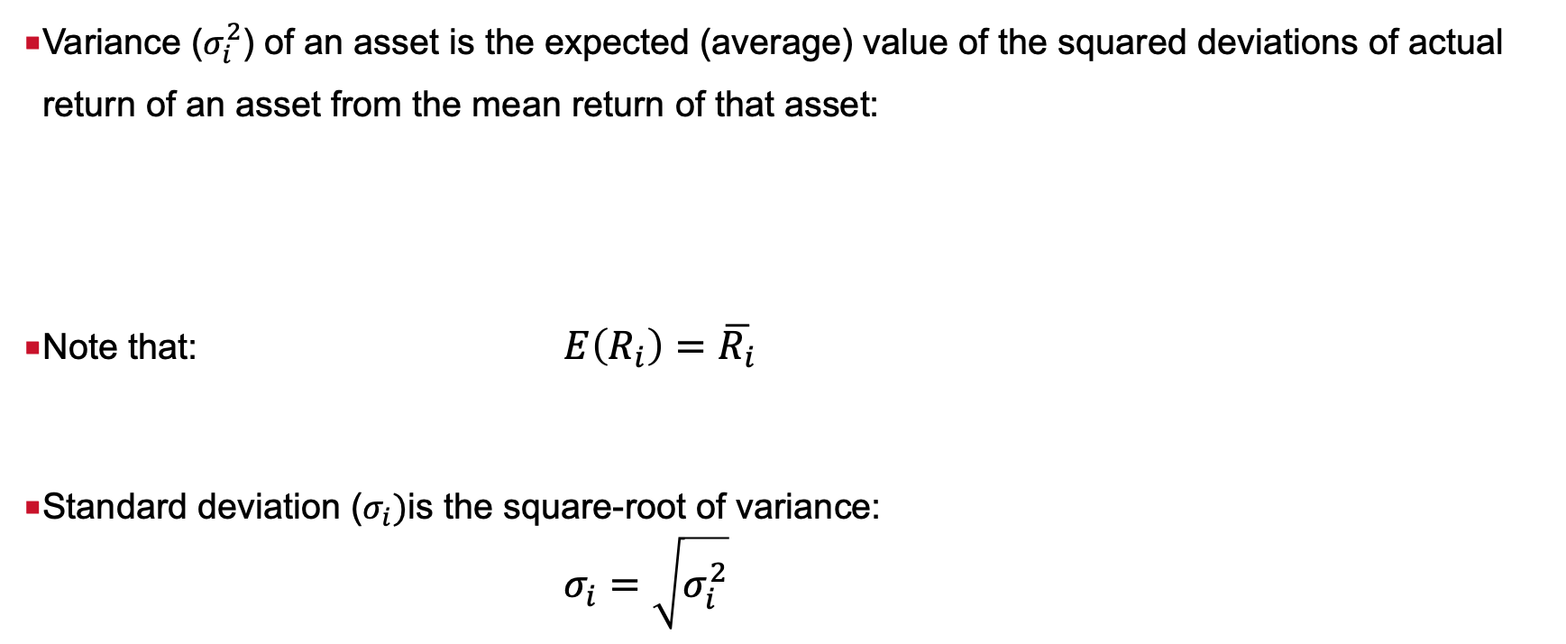
Variance and standard deviation
Variance ($σ_{i}^{2}$) of an asset is the expected (average) value of the squared deviations of actual return of an asset from the mean return of that asset:
Note that: $E\left(R_{i}\right)=\overline{R_{i}}$
Standard deviation ($σ_{i})$is the square-root of variance:
  $σ_{i}=\sqrt{σ_{i}^{2}}$

Slide 8
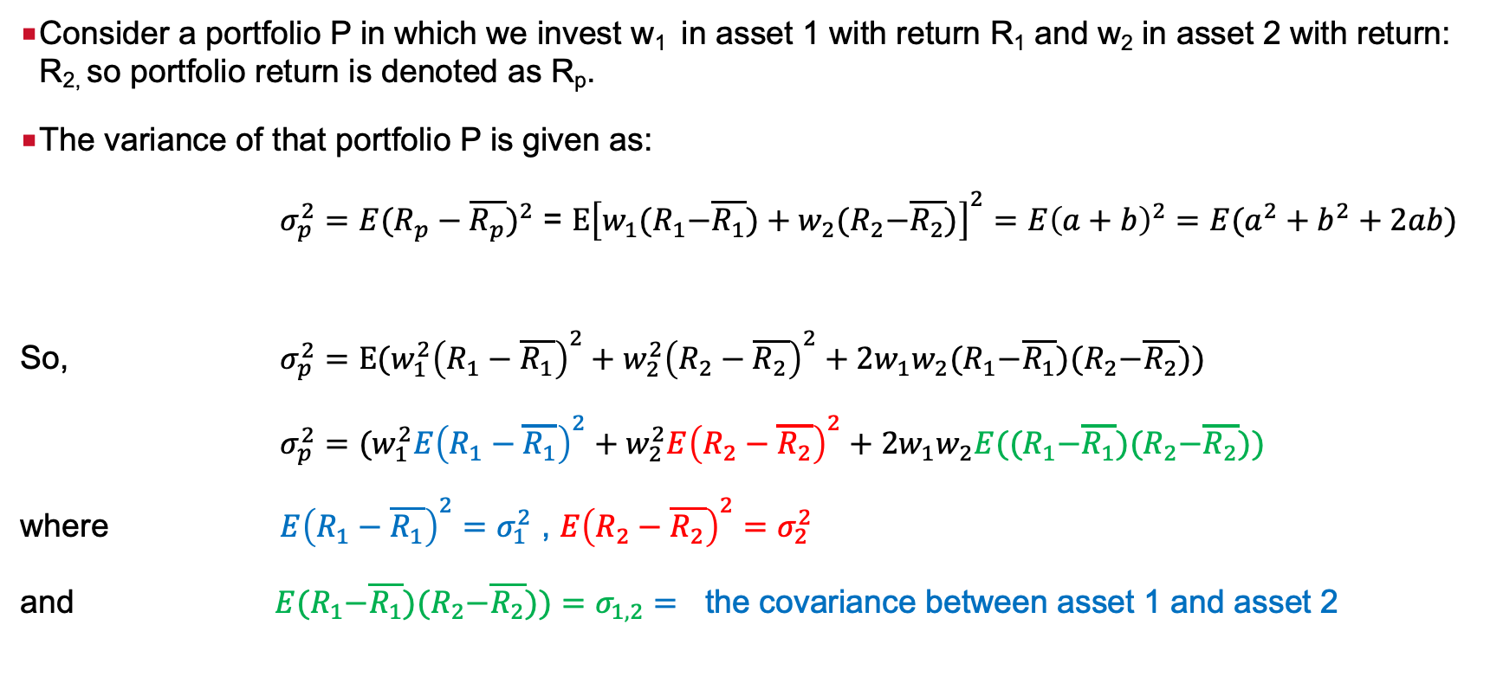
Variance and standard deviation of a two-asset portfolio
Consider a portfolio P in which we invest w₁ in asset 1 with return R₁ and w₂ in asset 2 with return: R_{2,} so portfolio return is denoted as R_{p}.
The variance of that portfolio P is given as:
$σ_{p}^{2}={E(R_{p}−\overline{R_{p}})}^{2}$ = $E{\left[w_{1}{(R}_{1}−\overline{R_{1}})+w_{2}{(R}_{2}−\overline{R_{2}})\right]}^{2}={E\left(a+b\right)}^{2}={E(a}^{2}+b^{2}+2ab)$
So, $σ_{p}^{2}=E{{{(w}_{1}^{2}\left(R_{1}−\overline{R_{1}}\right)}^{2}+{w_{2}^{2}\left(R_{2}−\overline{R_{2}}\right)}^{2}+2w_{1}w_{2}{(R}_{1}−\overline{R_{1}}){(R}_{2}−\overline{R_{2}}))}^{}$
$σ_{p}^{2}={(w}_{1}^{2}E{{\left(R_{1}−\overline{R_{1}}\right)}^{2}+{w_{2}^{2}E\left(R_{2}−\overline{R_{2}}\right)}^{2}+2w_{1}w_{2}E{((R}_{1}−\overline{R_{1}}){(R}_{2}−\overline{R_{2}})) }^{}$
where ${E\left(R_{1}−\overline{R_{1}}\right)}^{2}=$ $σ_{1}^{2}$ , ${E\left(R_{2}−\overline{R_{2}}\right)}^{2}=$ $σ_{2}^{2}$
and $E{(R}_{1}−\overline{R_{1}}){(R}_{2}−\overline{R_{2}}))=σ_{1,2}=$ the covariance between asset 1 and asset 2

Slide 9
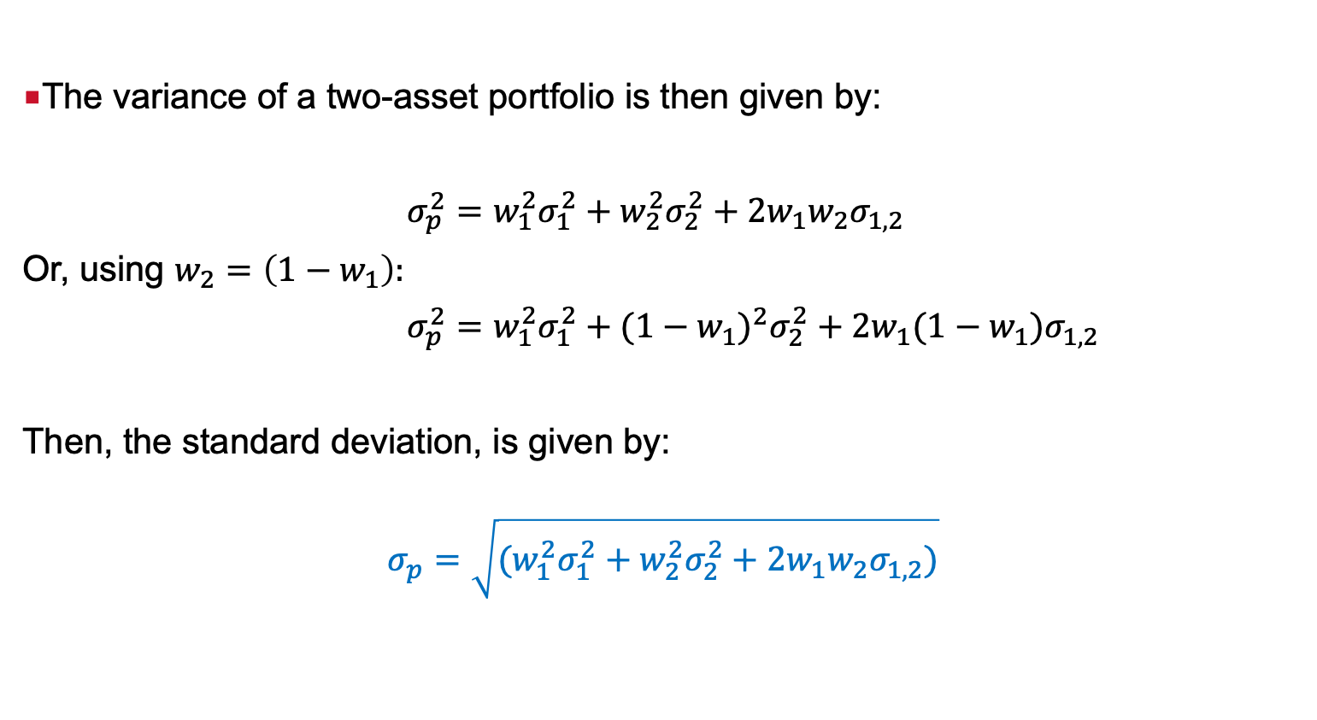
Variance and standard deviation of a two-asset portfolio
The variance of a two-asset portfolio is then given by:
$σ_{p}^{2}=$ $w_{1}^{2}σ_{1}^{2}+w_{2}^{2}σ_{2}^{2}+2w_{1}w_{2}σ_{1,2}$
Or, using $w_{2}=\left(1−w_{1}\right):$
$σ_{p}^{2}=$ $w_{1}^{2}σ_{1}^{2}+(1−w_{1})^{2}σ_{2}^{2}+2w_{1}(1−w_{1})σ_{1,2}$
Then, the standard deviation, is given by:
$$σ_{p}=\sqrt{(w_{1}^{2}σ_{1}^{2}+w_{2}^{2}σ_{2}^{2}+2w_{1}w_{2}σ_{1,2})}$$

Slide 10
Diversification

Slide 11
Diversification
Leading to the reduction of the total risk of the portfolio
Portfolio return: weighted average of the expected returns of each component asset in the portfolio
Portfolio risk: NOT a weighted average of the risks of securities in the portfolio
  It depends on the correlation coefficient/covariance between the assets
Diversification is achieved by:
Having low or negative correlation/covariance between pars of assets in the portfolio or
Having large number of assets in a portfolio

Slide 12
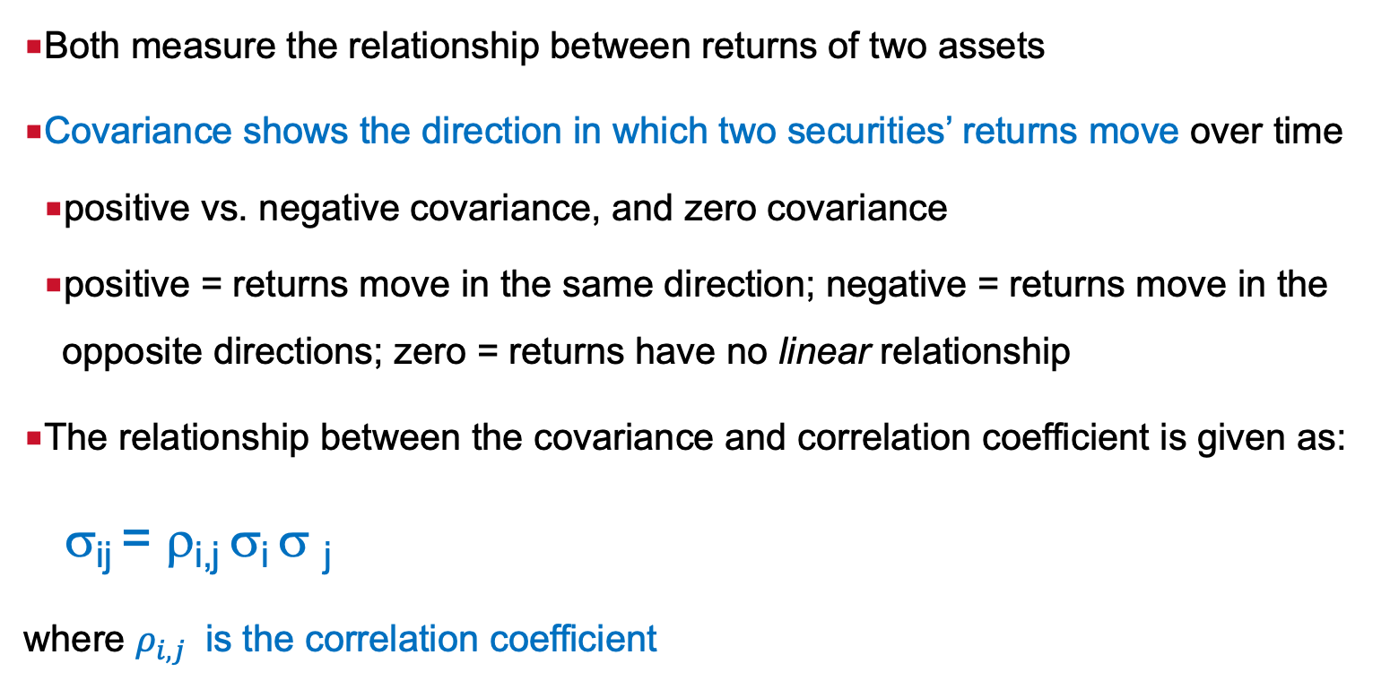
Covariance and correlation coefficient
Both measure the relationship between returns of two assets
Covariance shows the direction in which two securities’ returns move over time
  positive vs. negative covariance, and zero covariance
  positive = returns move in the same direction; negative = returns move in the opposite directions; zero = returns have no linear relationship
The relationship between the covariance and correlation coefficient is given as:
σ_{ij} = ρ_{i,j} σ_{i} σ _{j}
where $ρ_{i,j}$ is the correlation coefficient

Slide 13
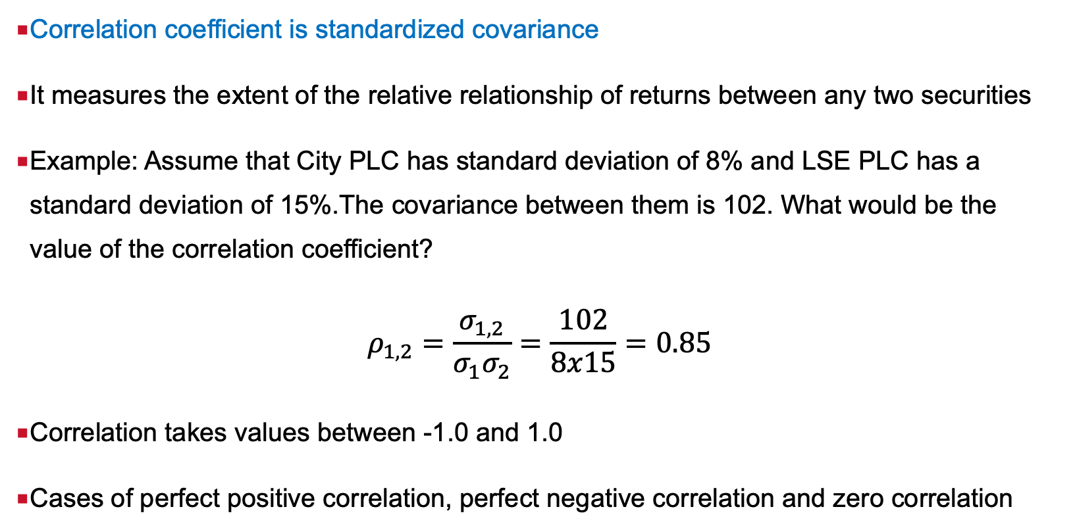
Correlation coefficient
Correlation coefficient is standardized covariance
It measures the extent of the relative relationship of returns between any two securities
Example: Assume that City PLC has standard deviation of 8% and LSE PLC has a standard deviation of 15%.The covariance between them is 102. What would be the value of the correlation coefficient?
$$ρ_{1,2}=\frac{σ_{1,2}}{σ_{1}σ_{2}}=\frac{102}{8x15}=0.85$$
Correlation takes values between -1.0 and 1.0
Cases of perfect positive correlation, perfect negative correlation and zero correlation

Slide 14
The impact of correlation coefficient/covariance on diversification

Slide 15
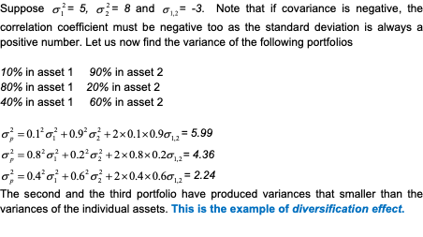
Risk Reduction With Low Covariance (Correlation)

Slide 16
Correlation and risk reduction
If the correlation coefficient is +1: the risk of a two-asset portfolio can only be the average risk of the two assets – there is no risk reduction as they move perfectly together.
If the correlation is -1: the risk of a two-asset portfolio can be brought down to zero, i.e. one can compute which weight assigned to asset 1 and asset 2 would produce zero variance (standard deviation)
If the correlation is 0: there is risk reduction, the risk is lower than when the correlation is +1 but higher than when the correlation is -1.
These points will be proven mathematically later in this lecture.

Slide 17
Diversification and large number of assets

Slide 18
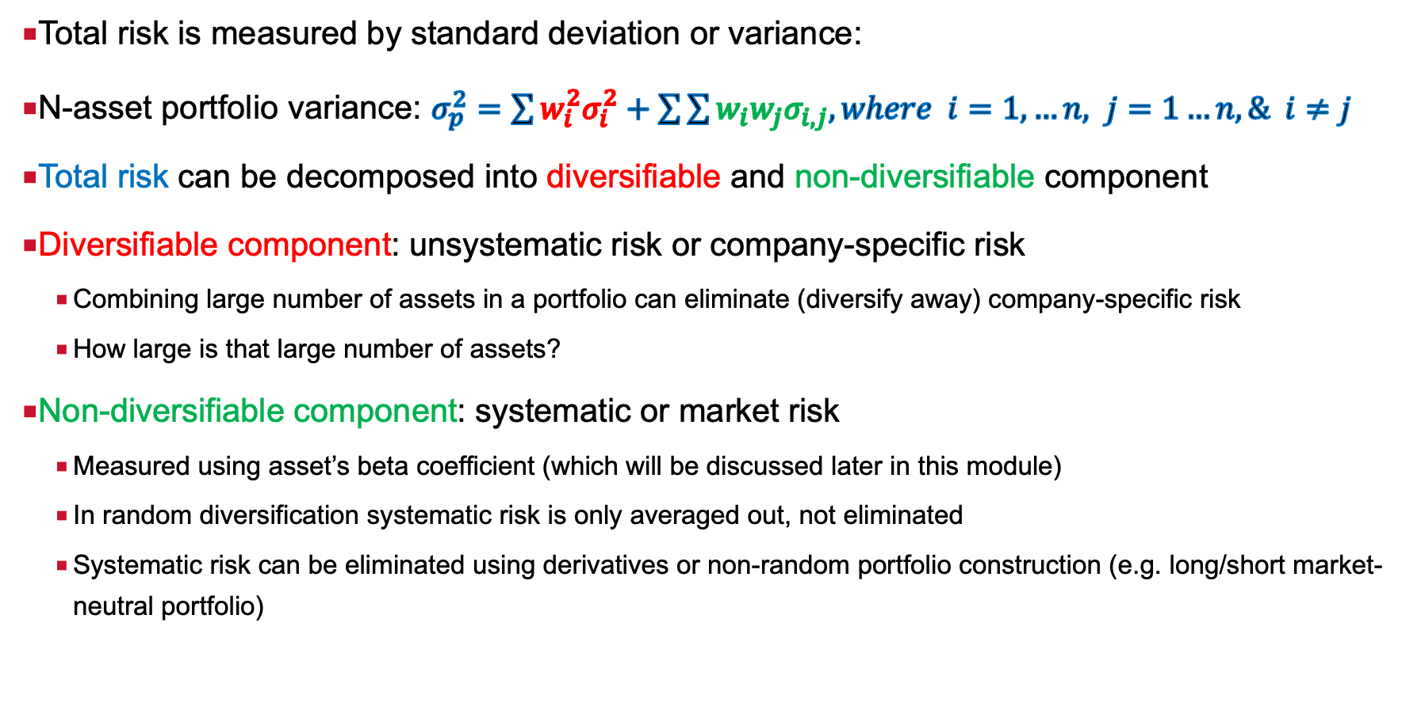
Total risk of a portfolio
Total risk is measured by standard deviation or variance:
N-asset portfolio variance: $σ_{p}^{2}=\sum{w_{i}^{2}σ_{i}^{2}+\sum{\sum{w_{i}w_{j}σ_{i,j}, where i=1, …n, j=1…n, \& i≠j}}}$
Total risk can be decomposed into diversifiable and non-diversifiable component
Diversifiable component: unsystematic risk or company-specific risk
    Combining large number of assets in a portfolio can eliminate (diversify away) company-specific risk
    How large is that large number of assets?
Non-diversifiable component: systematic or market risk
    Measured using asset’s beta coefficient (which will be discussed later in this module)
    In random diversification systematic risk is only averaged out, not eliminated
    Systematic risk can be eliminated using derivatives or non-random portfolio construction (e.g. long/short market-neutral portfolio)

Slide 19
Diversification and the number of assets held in the portfolio, cont.
If all risk is company-specific, covariance is equal to zero
Then, as the number of assets in the portfolio increases the portfolio variance will approach zero
In reality, assets are positively correlated, and their total risk has a market risk component as well
Therefore, the variance term will still approach zero, but the covariance term will approach the average covariance as the number of assets increases
Conclusion: company-specific risk can be driven to 0, while the market risk cannot be diversified away as we increase the number of assets in the portfolio

Slide 20
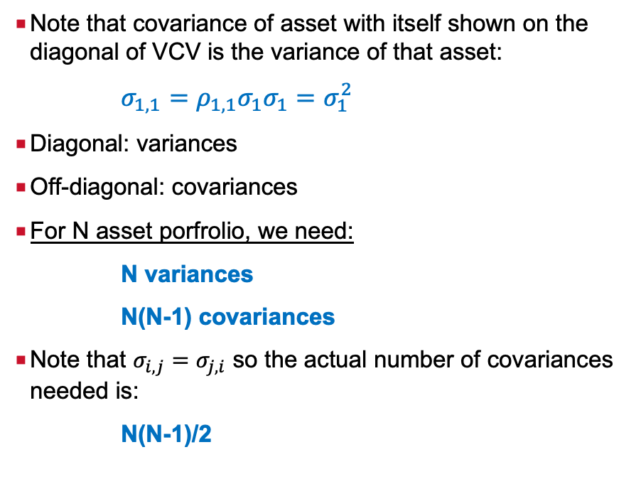
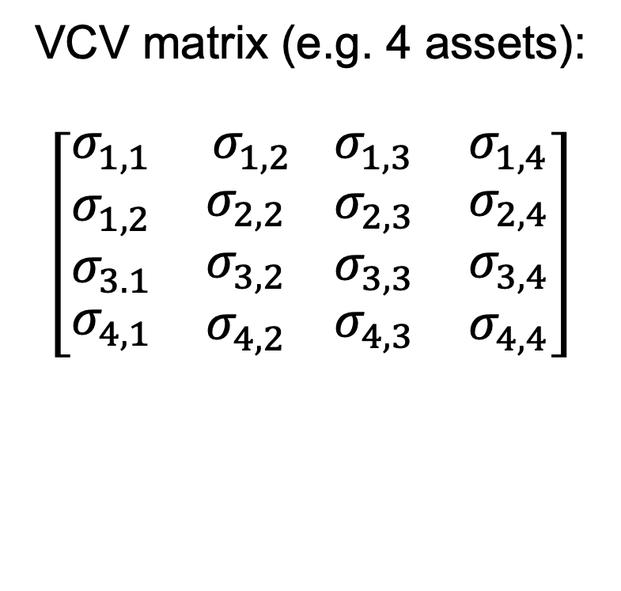
Needed for excel files and video on Moodle:
Portfolios of N-assets: How many variances and covariances do we need? Variance-Covariance Matrix (VCV)
VCV matrix (e.g. 4 assets):
$$\left[\begin{matrix}σ_{1,1} & σ_{1,2} \\ \begin{aligned}\begin{aligned}σ_{1,2} \\ σ_{3.1}\end{aligned} \\ σ_{4,1}\end{aligned} & \begin{aligned}σ_{2,2} \\ σ_{3,2} \\ σ_{4,2}\end{aligned} \end{matrix}\begin{matrix}σ_{1,3} & σ_{1,4} \\ \begin{aligned}\begin{aligned}σ_{2,3} \\ σ_{3,3}\end{aligned} \\ σ_{4,3}\end{aligned} & \begin{aligned}σ_{2,4} \\ σ_{3,4} \\ σ_{4,4}\end{aligned}\end{matrix}\right]$$
Note that covariance of asset with itself shown on the diagonal of VCV is the variance of that asset:
$σ_{1,1}=ρ_{1,1}σ_{1}σ_{1}=σ_{1}^{2}$
Diagonal: variances
Off-diagonal: covariances
For N asset porfrolio, we need:
N variances
N(N-1) covariances
Note that $σ_{i,j}=σ_{j,i}$ so the actual number of covariances needed is:
N(N-1)/2
Notes:
To use the Markowitz model one needs data for the returns and standard deviations of each individual security under consideration as well as the correlation coefficients for each pair of securities. Deriving efficient frontiers using a large universe of securities is quite complicated because of the large number of data inputs. Generating inputs for correlation coefficient is a very demanding for the fund manager. The heavy input requirements make it a demanding computational problem. Computer memory requirements are heavy and and a few years was almost impossible to solve the problem when a large number was involved.

Slide 21
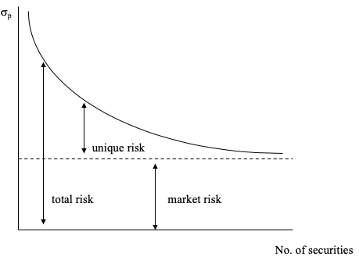
Diversification and the number of assets held in the portfolio, cont.
Fama (1976): Company-specific risk can be driven to 0, while the market risk cannot be diversified away as we increase the number of assets in the portfolio.
In the original studies on diversification, number of randomly selected assets needed to diversify a portfolio risk was 25-30 (more recent studies suggest that number is around 200)

Slide 22
Diversification - concluding comments
Diversification is not minimising but averaging market risk
Portfolio returns always depend on market conditions
Unique or company specific risk can substantially be reduced by diversification
30 or more randomly selected securities will form a portfolio with small company specific risk
The lower the correlation between the assets in the portfolio, the the greater the possibility of risk reduction

Slide 23
Determining the efficient sets of two-asset portfolios and proof of how correlation is impacting two-asset portfolio risk

Slide 24
Determining the efficient set (efficient frontier)
  Mean-variance decision rule developed by Markowitz (1952):
  The rule: portfolio A dominates portfolio B if
    its expected return is greater or equal to the expected return of B and the variance of A is lower than the variance of portfolio B
    its expected return is greater than the expected return of B and the variance of A is lower or equal to variance of B
  The result: investors choose a set of portfolios that provide them with minimum risk and maximum return
  The shape of the efficient frontier depends on the size of the correlation coefficients between the assets

Slide 25
Two-asset portfolios efficient set: perfectly positively correlated assets
Returns in reality can be highly but not perfectly positively correlated
Variance of the portfolio with perfect positive correlation between assets, the case of the two-asset portfolio:
σ_{p}² = w₁² σ₁² + w₂² σ₂² + 2w₁w₂ρ_{1,2} σ₁ σ₂
If: ρ_{1,2} = +1
Then: σ_{p}² = w₁² σ₁² + w₂² σ₂² + 2w₁w₂σ₁ σ₂
σ_{p}² =[ w₁ σ₁ + w₂ σ₂] ²
And σ_{p} = w₁ σ₁ + w₂ σ₂
The standard deviation of a portfolio is equal to the weighted average of the standard deviation of the component securities when correlation = +1

Slide 26
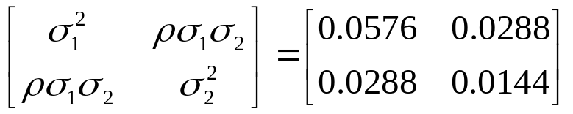
Two-asset portfolios efficient set: perfectly positively correlated assets
Key point: the risk is not reduced when assets are perfectly positively correlated - it is a linear combination of the assets in the portfolio
Example:
For ρ_{1,2} = +1, Variance-Covariance matrix =
 | Equity (E) | Bond (B)
Expected Return | 18% | 7.5%
Risk (Standard Deviation) | 24% | 12%
Variance | 5.76 | 1.44

Slide 27
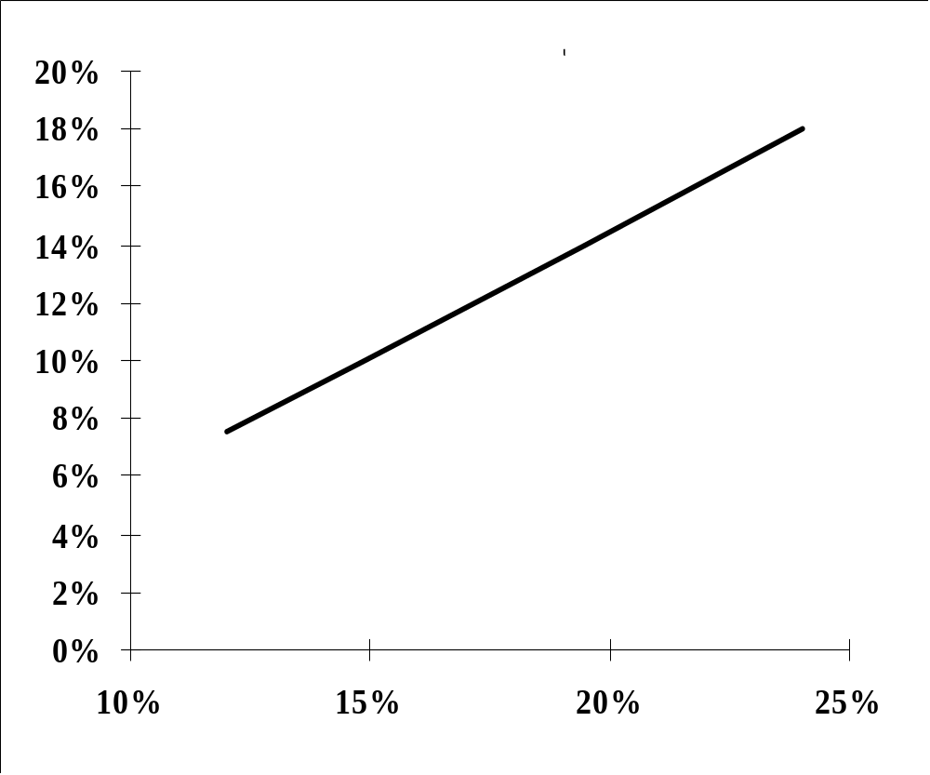
Two-asset portfolios efficient set shape: perfectly positively correlated assets
Equity Allocation | Bond Allocation | Portfolio Return | Portfolio Variance | Portfolio Std. deviation
0.000 | 1.000 | 7.5% | 1.4% | 12.00%
0.238 | 0.762 | 10.0% | 2.2% | 14.86%
0.619 | 0.381 | 14.0% | 3.8% | 19.43%
1.000 | 0.000 | 18.0% | 5.8% | 24.00%
E
B

Slide 28
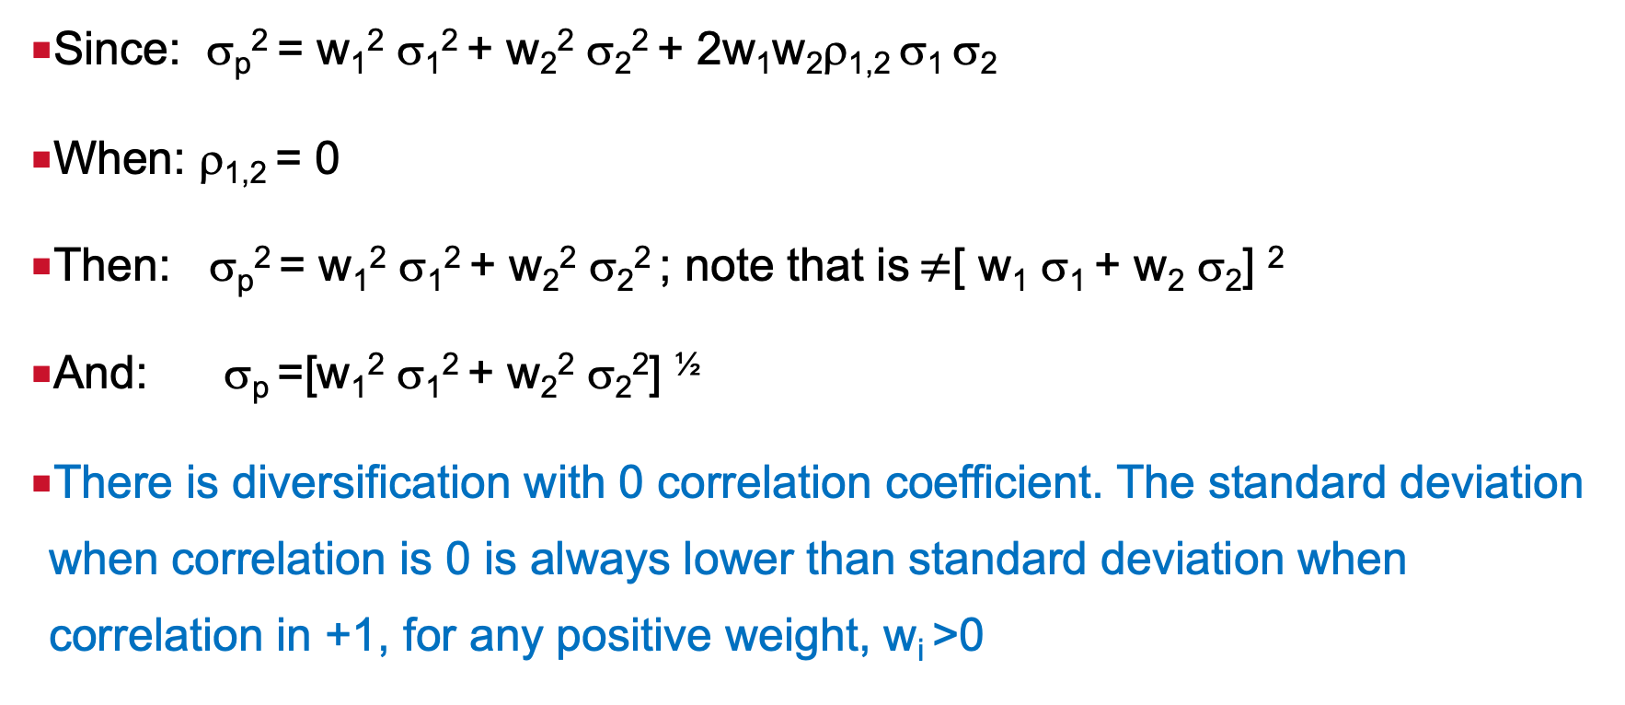
Two-asset portfolios efficient set: zero correlation between assets
Since: σ_{p}² = w₁² σ₁² + w₂² σ₂² + 2w₁w₂ρ_{1,2} σ₁ σ₂
When: ρ_{1,2} = 0
Then: σ_{p}² = w₁² σ₁² + w₂² σ₂² ; note that is $≠$[ w₁ σ₁ + w₂ σ₂] ²
And: σ_{p} =[w₁² σ₁² + w₂² σ₂²] ^{½}
There is diversification with 0 correlation coefficient. The standard deviation when correlation is 0 is always lower than standard deviation when correlation in +1, for any positive weight, w_{i} >0

Slide 29
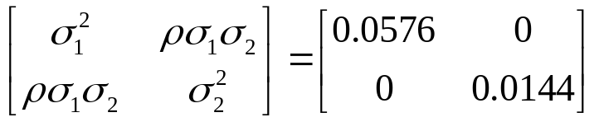
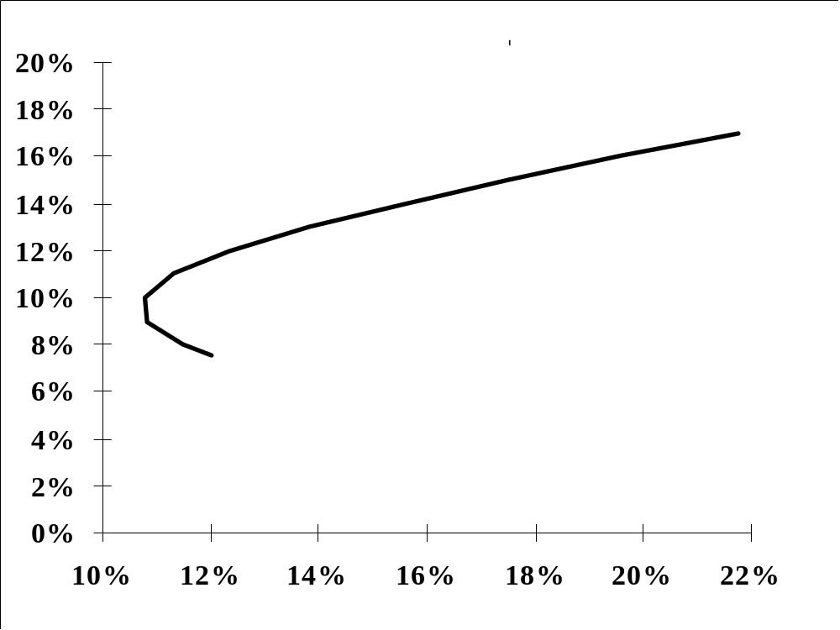
Two-asset portfolios efficient set shape: zero correlation between assets
ρ_{1,2} = 0, so Variance-covariance matrix =
Equity Allocation | Bond Allocation | Portfolio Return | Portfolio Variance | Portfolio Standard deviation
0 | 1 | 7.5% | 1.44% | 12.00%
0.0476 | 0.9524 | 8% | 1.32% | 11.49%
0.1429 | 0.8571 | 9% | 1.18% | 10.84%
0.2381 | 0.7619 | 10% | 1.16% | 10.78%
0.3333 | 0.6667 | 11% | 1.28% | 11.31%
0.4286 | 0.5714 | 12% | 1.53% | 12.36%
0.5238 | 0.4762 | 13% | 1.91% | 13.81%
0.6190 | 0.3810 | 14% | 2.42% | 15.54%
0.7143 | 0.2857 | 15% | 3.06% | 17.48%
0.8095 | 0.1905 | 16% | 3.83% | 19.56%
0.9048 | 0.0952 | 17% | 4.73% | 21.74%
1 | 0 | 18% | 5.76% | 24.00%
E
B

Slide 30
Two-asset portfolios efficient set: perfectly negatively correlated assets
Possibility to form a risk-free portfolio consisting of two risky assets – maximum risk reduction
If we set the standard deviation of the portfolio to be zero, we can calculate the proportion we need to invest in each asset, to form a zero-variance portfolio.
  Using the previous example, but changing the correlation to -1:
  σ_{p}² = w₁² σ₁² + w₂² σ₂² - 2w₁w₂σ₁ σ₂ = [ w₁ σ₁ - w₂ σ₂] ² = 0
  w₁ * 0.24 - (1- w₁) * 0.12 = 0
  0.24w₁ - 0.12 + 0.12 w₁ = 0
  0.36w₁ = 0.12
  w₁ = 0.3333 = 33.33%
  w₂ = 1-w₁ = 0.6667 = 66.67%

Slide 31
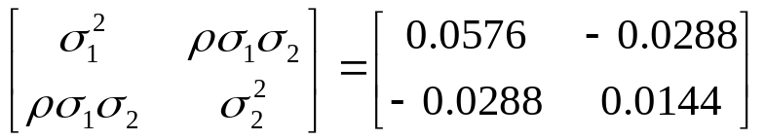
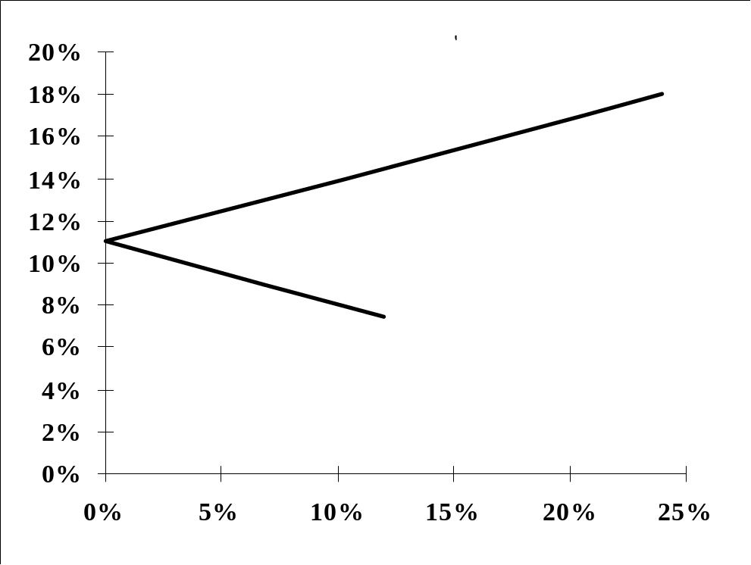
Two-asset portfolios efficient set: perfectly negatively correlated assets
ρ_{1,2} = -1, so Variance-covariance matrix =
Equity Allocation | Bond Allocation | Portfolio Return | Portfolio Variance | Portfolio Standard deviation
0 | 1 | 7.5% | 1.4% | 12%
0.143 | 0.857 | 9.0% | 0.5% | 7%
0.333 | 0.667 | 11.0% | 0.0% | 0%
0.619 | 0.381 | 14.0% | 1.1% | 10%
0.905 | 0.095 | 17.0% | 4.2% | 21%
1 | 0 | 18.0% | 5.8% | 24%
E
B

Slide 32
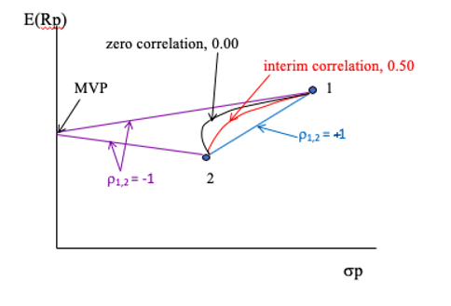
Realistic scenario: e.g. intermediate correlation
(-1< ρ_{1,2} <+1) between assets
MVP = Minimum Variance Portfolio
Intermediate correlation, e.g. ρ_{1,2} =0.5

Slide 33
Determining the efficient set of N-asset portfolio
(Markowitz Efficient Frontier)

Slide 34
N-asset portfolios: determining the efficient frontier
Feasible set or opportunity set: all combinations of portfolios formed from N securities available to an investor
Efficient set: portfolios at the top part of feasible set, i.e. portfolios with minimum risk and maximum return
Mean-variance rule: optimal (best) portfolio is chosen from the efficient set of portfolios that
  offer maximum expected return for varying levels of risk
  offer minimum risk for varying levels of expected return

Slide 35
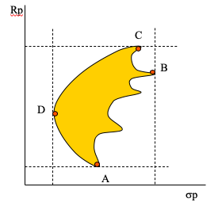
Application of the efficient set rule to the feasible set
Application of the rule highlights four portfolios A, B, C, D
Minimum Variance Frontier – portfolios with minimum risk for a given level of return is boundary between A and C
Efficient Frontier – portfolios with maximum returns for given level of risk is boundary between points D and C

Slide 36
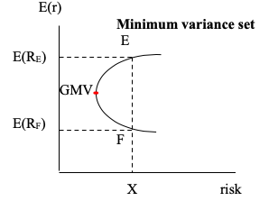
The the minimum variance set and efficient set
Mean-variance rule helps investors to determine the minimum-variance set (frontier): Portfolio E dominates portfolio F
GMV: Global Minimum Variance Portfolio – portfolio with minimum risk
All portfolios above GMV are Efficient portfolios, i.e. efficient set
Efficient set
Inefficient set

Slide 37
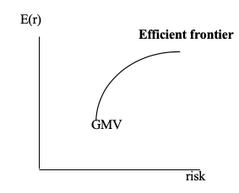
The efficient frontier of risky assets
Concave curve from GMV upwards
Investing in any two portfolios on the efficient frontier (1&2 on the graph) will form a third portfolio (3 on the graph), that will also be efficient. That new portfolio (3) will have to lie on the concave segment between the two portfolios (1&2) used to construct it.

Slide 38
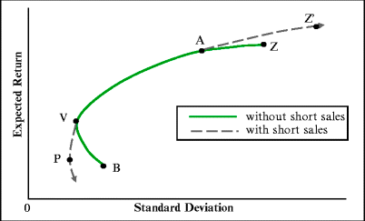
Minimum variance set and efficient set with short-selling of risky assets
The minimum variance/efficient set extends, so both maximum return and risk are increased.
e.g. short-sell B, invest proceeds in A and extend the frontier towards Z’
In theory there is no limit as to how much one can short-sell, in reality there are constraints.

Slide 39
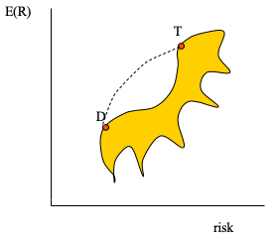
The shape of the efficient frontier - impossibility of having ‘dents’
Consider efficient frontier with a dent between D and T
When investing partly in D and partly in T, the DT portfolio would have to be to the left of the efficient set presented (because correlations of less than +1 reduce risk in a portfolio and shift it to the left on the E(R)/risk graph)

Slide 40
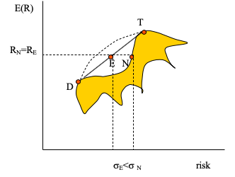
The shape of the efficient frontier - impossibility of having ‘dents’, cont.
According to the graph, portfolio N is an efficient portfolio
Note that we can construct portfolio E (combination of D and T in the worst-case scenario for diversification, i.e. when ρ_{D,T} = +1) that has the same expected return but lower standard deviation than N
Then, N cannot be efficient as it does not have lower risk risk given the same level of return as E.
That means, the reason why efficient frontier of risky assets must be concave lies in the fact that correlation coefficients of any two assets forming portfolios on the frontier is between -1 and +1.

Slide 41
Reading
Elton, Gruber, Brown and Goetzmann, relevant parts of Chapter 4 “The Characteristics of Opportunity Sets under Risk” and parts of Chapter 5 “Delineating Efficient Portfolios” in “Modern Portfolio Theory and Investment Analysis”
Bodie, Kane and Marcus, ”Investments” : Ch 5 “Risk, Return and Historical Record” (for risk and return) and parts of Ch 7 “Optimal Risky Portfolios”

Slide 42
Contact: natasha.todorovic.1@city.ac.uk
Room 4031
Bayes Business School, Bunhill Row, Level 4

